Slide 1
Implementation of Softmax Regression from Scratch
Eng Teong Cheah

Slide 2
Objective
With softmax regression, we can train models for multi-category classification. The training loop is very similar to that in linear regression: retrieve and read data, define models and loss functions, then train models using optimization algorithms. As you’ll soon find out, most common deep learning models have similar training procedures.

Slide 3
Contents
Implementation of Softmax Regression from Scratch

Slide 4

Implementation of Softmax Regression from Scratch

Slide 5
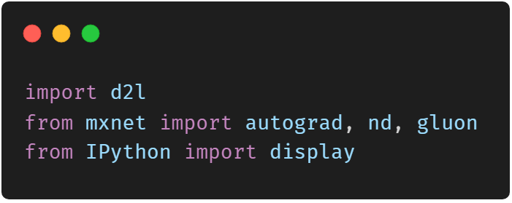
Implementation of Softmax Regression from Scratch

Slide 6
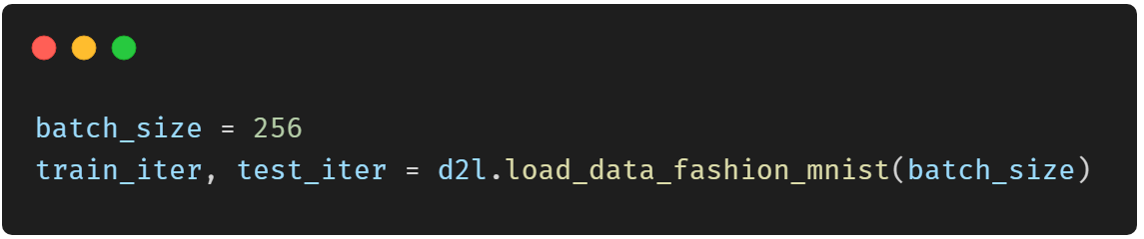
Implementation of Softmax Regression from Scratch

Slide 7
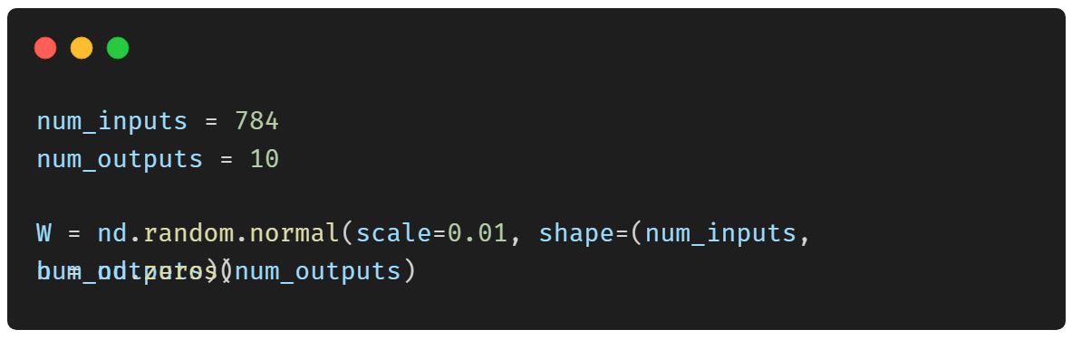
Initialize Model Parameters

Slide 8
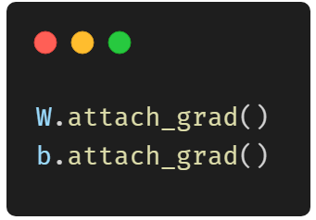
Initialize Model Parameters

Slide 9
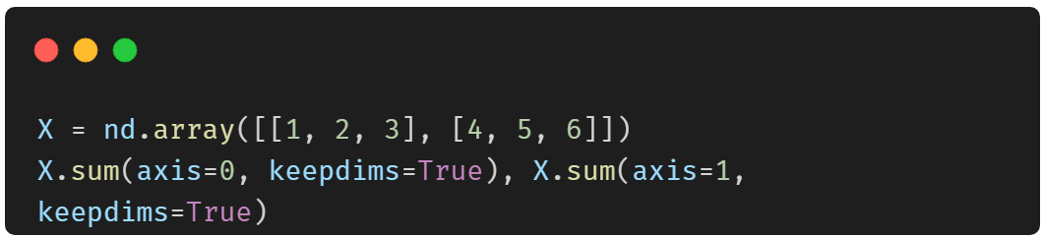
The Softmax

Slide 10
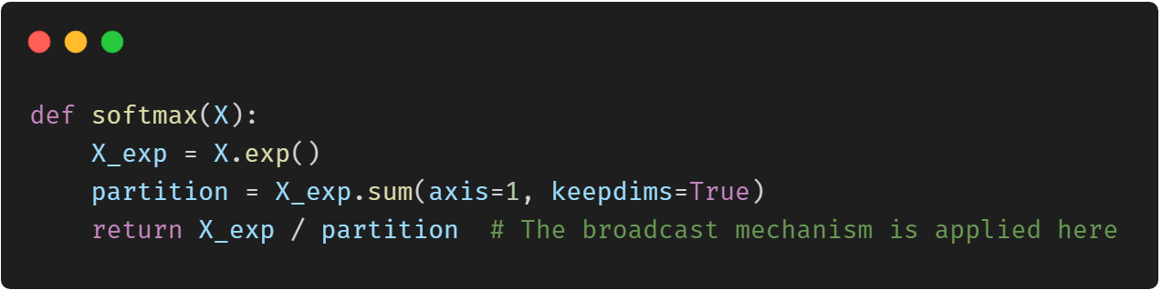
The Softmax

Slide 11
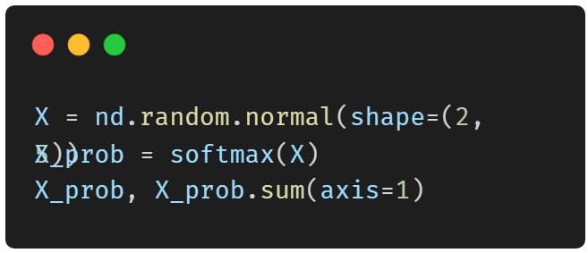
The Softmax

Slide 12
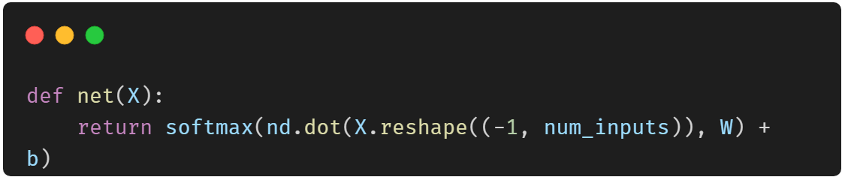
The Model

Slide 13
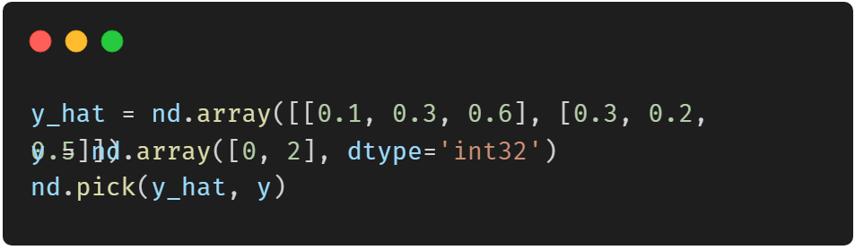
The Loss Function

Slide 14
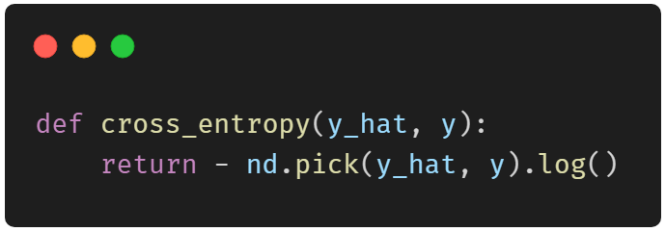
The Loss Function

Slide 15
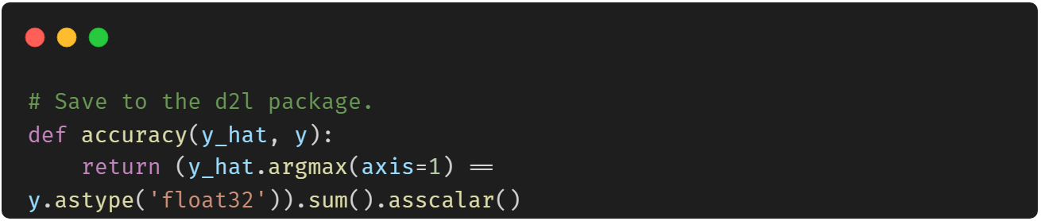
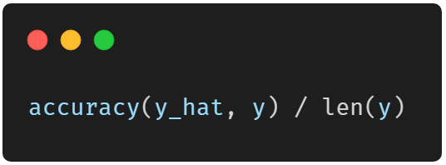
Classification Accuracy

Slide 16
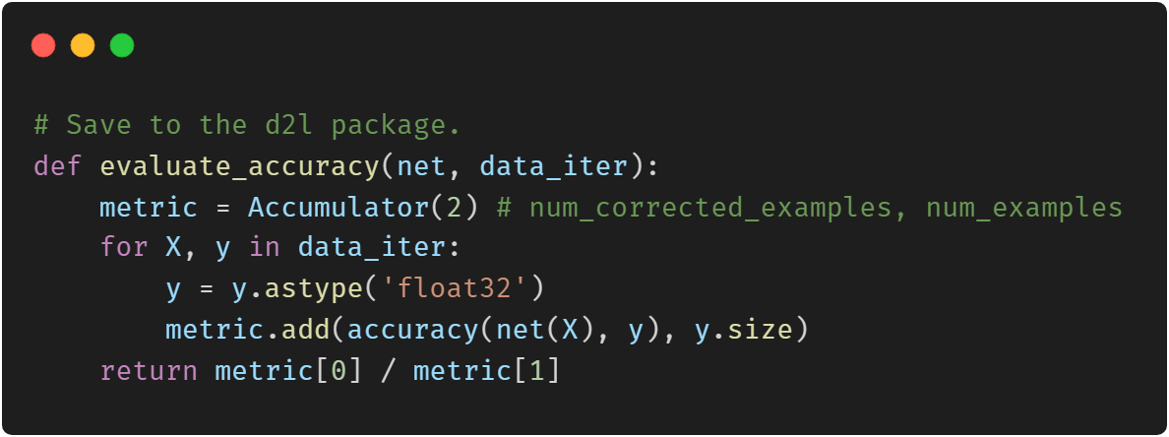
Classification Accuracy

Slide 17
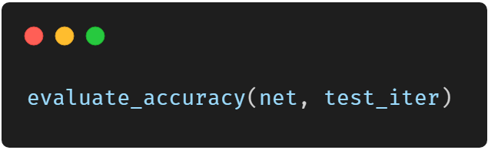
Classification Accuracy

Slide 18
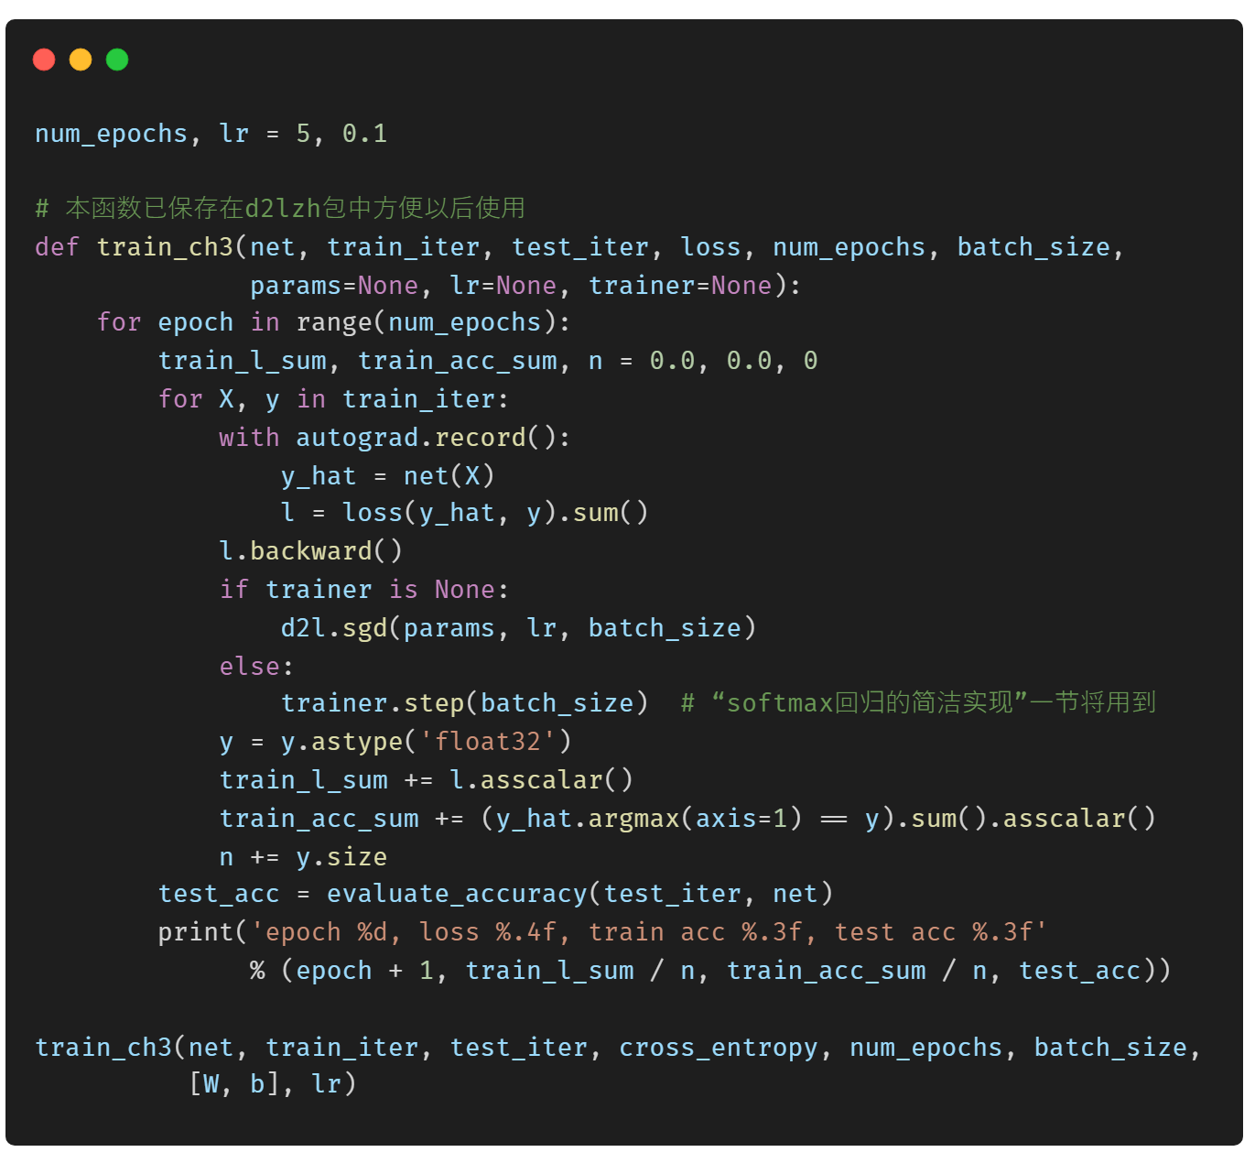
Model Training

Slide 19
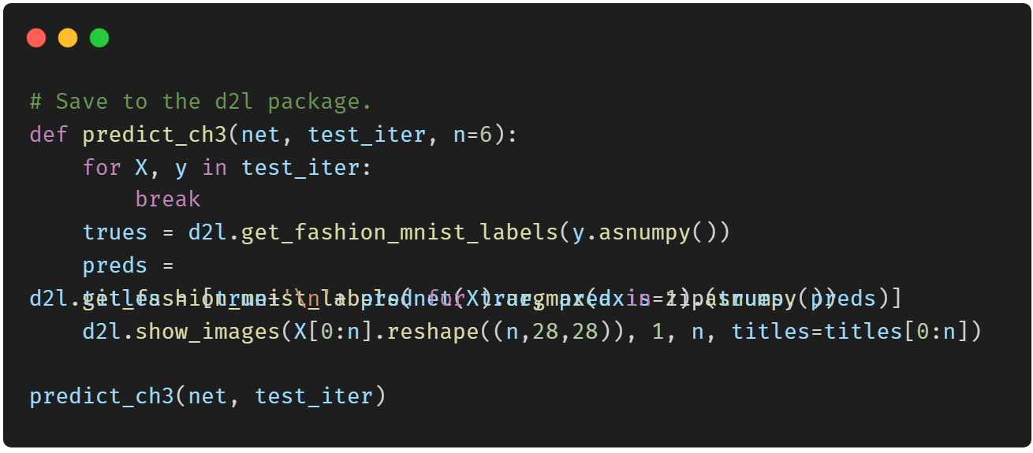
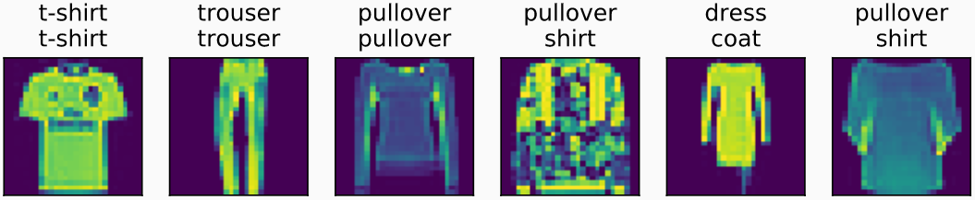
Prediction

Slide 20
Thank You!
Does anyone have any questions?
Twitter: @walkercet
Blog: https://ceteongvanness.wordpress.com

Slide 21
Resources
Dive into Deep Learning

